Slide 1
Design and Analysis of Algorithms
CSC 413
LECTURE 6
Topic: Algorithmic Strategies I – Brute-force and Divide-and-Conquer
Lecture Note Presentation

Slide 2
Introduction
Algorithmic problem-solving is central to computer science. Many problems can be solved using multiple strategies, each with different implications for efficiency, simplicity, and scalability.
This module introduces two foundational algorithmic paradigms: Brute-Force and Divide-and-Conquer. Although brute-force provides the most straightforward approach to problem solving, divide-and-conquer offers a systematic way to design more efficient algorithms by breaking problems into smaller components.

Slide 3
Brute-Force Algorithmic Strategy
Concept: Brute-force is the most direct and exhaustive approach to solving a problem. It attempts all possible solutions or follows straightforward procedural steps without attempting to optimize or reduce the search space.
Characteristics
  Simple, intuitive, and easy to implement.
  Often inefficient for large inputs.
  Provides a baseline solution for comparison with advanced techniques.
When Brute-Force is Useful
  When the input size is small.
  When guaranteed correctness is more important than speed.
  When developing a reference solution to evaluate optimized algorithms.
Selection Sort, Bubble Sort, Sequential Search, String Matching, Depth-First Search and Breadth-First Search, Closest-Pair and Convex-Hull Problems can be solved by Brute Force.

Slide 4
Brute-Force Algorithmic Strategy
Examples:
  1. Computing an : a * a * a * … * a ( n times)
  2. Computing n! : The n! can be computed as n*(n-1)* … *3*2*1
  3. Multiplication of two matrices : C=AB
  4. Searching a key from list of elements (Sequential search)
Advantages:
  Brute force is applicable to a very wide variety of problems.
  It is very useful for solving small size instances of a problem, even though it is inefficient.
  The brute-force approach yields reasonable algorithms of at least some practical value with no limitation on instance size for sorting, searching, and string matching.
  The expense of designing a more efficient algorithm may be unjustifiable if only a few instances of a problem need to be solved and a brute-force algorithm can solve those instances with acceptable speed.

Slide 5
Brute-force Strategy: Selection Sort
First scan the entire given list to find its smallest element and exchange it with the first element, putting the smallest element in its final position in the sorted list.
Then scan the list, starting with the second element, to find the smallest among the last n − 1 elements and exchange it with the second element, putting the second smallest element in its final position in the sorted list.
Generally, on the ith pass through the list, which we number from 0 to n − 2, the algorithm searches for the smallest item among the last n − i elements and swaps it with A_{i}:
A₀ ≤ A₁ ≤ . . . ≤ Ai_{–1} | Ai , . . . , A_{min}, . . . , A_{n–1}
in their final positions | the last n – i elements
After n − 1 passes, the list is sorted.

Slide 6
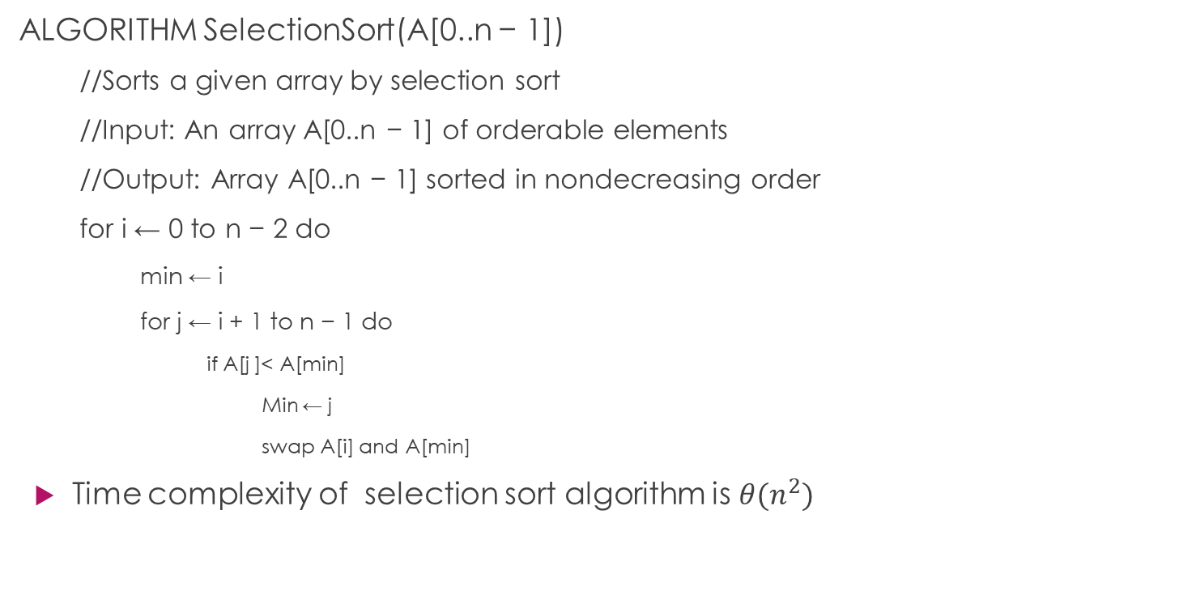
Brute-force Strategy: Selection Sort
ALGORITHM SelectionSort(A[0..n − 1])
  //Sorts a given array by selection sort
  //Input: An array A[0..n − 1] of orderable elements
  //Output: Array A[0..n − 1] sorted in nondecreasing order
  for i ← 0 to n − 2 do
    min ← i
    for j ← i + 1 to n − 1 do
      if A[j ]< A[min]
        Min ← j
        swap A[i] and A[min]
Time complexity of selection sort algorithm is $θ(n^{2})$
Illustration of selection sort algorithm
89 | 45 | 68 | 90 | 29 | 34 | 17
17 | 45 | 68 | 90 | 29 | 34 | 89
17 | 29 | 68 | 90 | 45 | 34 | 89
17 | 29 | 34 | 90 | 45 | 68 | 89
17 | 29 | 34 | 45 | 90 | 68 | 89
17 | 29 | 34 | 45 | 68 | 90 | 89
17 | 29 | 34 | 45 | 68 | 89 | 90

Slide 7
Brute-force Strategy: Bubble Sort
Bubble Sort: The bubble sorting algorithm is to compare adjacent elements of the list and exchange them if they are out of order. By doing it repeatedly, we end up “bubbling up” the largest element to the last position on the list. The next pass bubbles up the second largest element, and so on, until after n − 1 passes the list is sorted. Pass i (0 ≤ i ≤ n − 1) of bubble sort can be represented by the following: A₀, . . . , A_{j} ? ↔ A_{j+1}, . . . , A_{n−i−1} | A_{n−i} ≤ . . . ≤ A_{n−1}
ALGORITHM BubbleSort(A[0..n − 1])
  //Sorts a given array by bubble sort
  //Input: An array A[0..n − 1] of orderable elements
  //Output: Array A[0..n − 1] sorted in nondecreasing order
  for i ← 0 to n − 1 do
    for j ← 0 to n − 1 − i do
      if A[j + 1] < A[J]
        Swap(A[j], A[j+1]
      Endif
    Endfor
  endfor
[89, 45, 68, 90, 29, 34, 17]
pass 0: [45, 89, 68, 90, 29, 34, 17]
[45, 68, 89, 90, 29, 34, 17]
[45, 68, 89, 90, 29, 34, 17]
[45, 68, 89, 29, 90, 34, 17]
[45, 68, 89, 29, 34, 90, 17]
[45, 68, 89, 29, 34, 17,| 90]
pass 1: [45, 68, 89, 29, 34, 17,| 90]
[45, 68, 89, 29, 34, 17,| 90]
[45, 68, 29, 89, 34, 17,| 90]
[45, 68, 29, 34, 89, 17,| 90]
[45, 68, 29, 34, 17, 89,| 90]
pass 2: [45, 68, 29, 34, 17, |89, 90]
[45, 29, 68, 34, 17, |89, 90]
[45, 29, 34, 68, 17,| 89, 90]
[45, 29, 34, 17, |68, 89, 90]
pass 3: [29, 45, 34, 17, |68, 89, 90]
[29, 34, 45, 17, |68, 89, 90]
[29, 34, 17, |45, 68, 89, 90]
pass 4: [29, 34, 17,|45, 68, 89, 90]
[29, 17, |34, 45, 68, 89, 90]
pass 5: [|17, 29, 34, 45, 68, 89, 90]

Slide 8
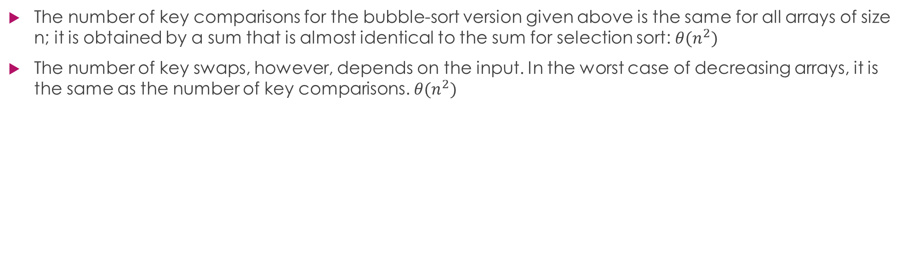
Brute-force Strategy: Bubble Sort
The number of key comparisons for the bubble-sort version given above is the same for all arrays of size n; it is obtained by a sum that is almost identical to the sum for selection sort: $θ(n^{2})$
The number of key swaps, however, depends on the input. In the worst case of decreasing arrays, it is the same as the number of key comparisons. $θ(n^{2})$

Slide 9
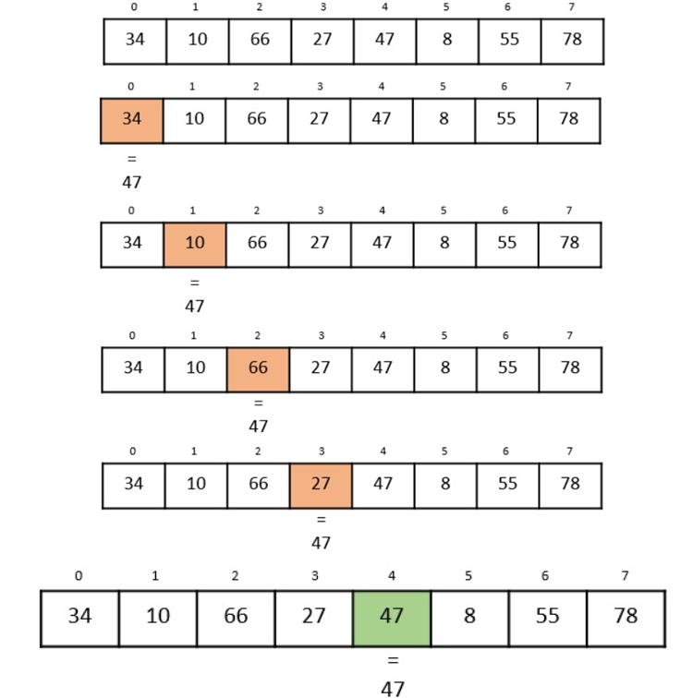
Brute-Force strategy: Linear search
Linear Search: Given an array and a target element, check each element sequentially until the target is found or the array ends.
1. Linear-search Algorithm:
  procedure linear_search (list, value)
    for each item in the list
      if match item == value
        return the item's location
      end if
    end for
  end procedure
Time Complexity:
  Worst case: O(n)
  Best case: O(1)

Slide 10
Brute-Force Strategy: Finding Maximum or minimum in a list
Finding Maximum or Minimum: Scan through the list and keep track of the largest or smallest element.
Algorithm: Max-Min-Element (numbers[])
  max := numbers[1]
  min := numbers[1]
  for i = 2 to n do
    if numbers[i] > max then
      max := numbers[i]
    if numbers[i] < min then
      min := numbers[i]
    return (max, min)
Complexity: O(n)

Slide 11
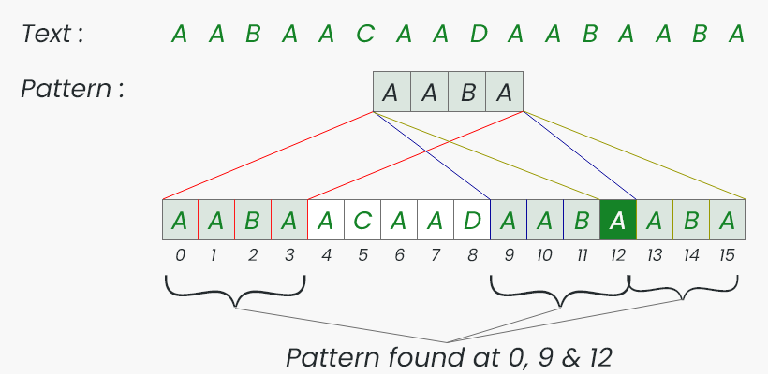
Brute-force Strategy: String Matching (Naïve Pattern Matching)
Check for the occurrence of a pattern P of length m in a text T of length n by comparing P with every substring of T.
Complexity: O(nm)

Slide 12
Brute-force Strategy: Exhaustive Search
For discrete problems in which no efficient solution method is known, it might be necessary to test each possibility sequentially in order to determine if it is the solution. Such exhaustive examination of all possibilities is known as exhaustive search, complete search or direct search.
Exhaustive search is simply a brute force approach to combinatorial problems (Minimization or maximization of optimization problems and constraint satisfaction problems).
Exhaustive Search is applied to the important problems like • Traveling Salesman Problem • Knapsack Problem • Assignment Problem.

Slide 13
Travelling Salesman Problem: Exhaustive Search Approach
The Travelling Salesman Problem (TSP) is a classical combinatorial optimization problem. It asks: Given a set of cities and the distances between them, what is the shortest possible tour that visits every city exactly once and returns to the starting city?
TSP can be stated as the problem of finding the shortest Hamiltonian circuit of the graph. (A Hamiltonian circuit is defined as a cycle that passes through all the vertices of the graph exactly once).
TSP is an NP-Hard problem, meaning no polynomial-time algorithm is known for solving it optimally for large instances. One of the most intuitive approaches is Exhaustive Search, also known as the Brute-Force Method.
Exhaustive search tries every possible tour and selects the tour with the minimum total distance. A tour in TSP is a permutation of all cities, and for n cities: Number of possible tours=(n−1)!
Time complexity: Exhaustive search requires checking all permutations :O((n−1)!)

Slide 14
Steps of the Exhaustive Search Algorithm for solving TSP
Choose a starting city (e.g., City 1).
Generate all permutations of the other n−1 cities.
For each permutation:
  Compute the total distance of the tour:
  start → cities in permutation order → start
Track the minimum distance found.
Return the shortest tour and its total cost.
Pseudocode
function TSP_ExhaustiveSearch(distance_matrix):
n = number of cities
min_cost = ∞
best_tour = None
cities = [2, 3, ..., n] // city 1 is fixed as start
for permutation P of cities:
cost = 0
current_city = 1
for next_city in P:
cost += distance[current_city][next_city]
current_city = next_city
cost += distance[current_city][1] // return to start
if cost < min_cost:
min_cost = cost
best_tour = [1] + P + [1]
return min_cost, best_tour

Slide 15
TSP Example
Given 4 cities with the following distance matrix. what is the shortest possible tour that visits every city exactly once and returns to the starting city?
Solution:
  Fix city 1 as starting point.
  The permutations of (2, 3, 4) are: (2, 3, 4),(2, 4, 3),(3, 2, 4), (3, 4, 2), (4, 2, 3), (4, 3, 2)
  Compute each tour distance
  Select the tour with minimum cost
  The minimum cost = 80
  Best tours:
    1 → 2 → 4 → 3 → 1
    1 → 3 → 4 → 2 → 1
From/To | 1 | 2 | 3 | 4
1 | 0 | 10 | 15 | 20
2 | 10 | 0 | 35 | 25
3 | 15 | 35 | 0 | 30
4 | 20 | 25 | 30 | 0
3. Compute each tour distance
Tour | ROUTE | COST
Tour 1 | 1 → 2 → 3 → 4 → 1 | 10 + 35 + 30 + 20 = 95
Tour 2 | 1 → 2 → 4 → 3 → 1 | 10 + 25 + 30 + 15 = 80
Tour 3 | 1 → 3 → 2 → 4 → 1 | 15 + 35 + 25 + 20 = 95
Tour 4 | 1 → 3 → 4 → 2 → 1 | 15 + 30 + 25 + 10 = 80
Tour 5 | 1 → 4 → 2 → 3 → 1 | 20 + 25 + 35 + 15 = 95
Tour 6 | 1 → 4 → 3 → 2 → 1 | 20 + 30 + 35 + 10 = 95

Slide 16
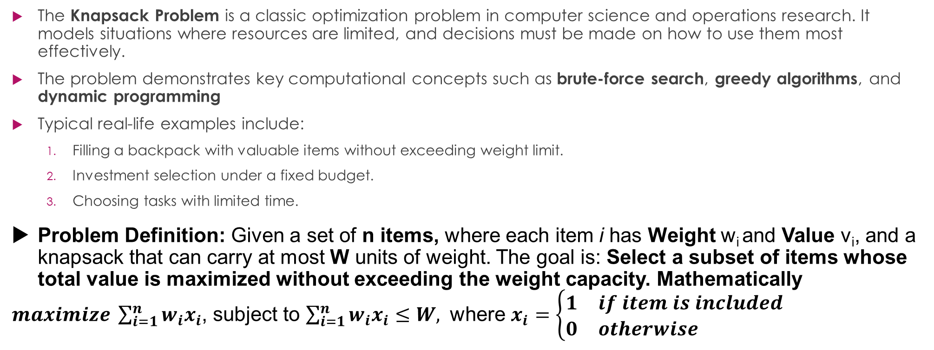
Knapsack Problem
The Knapsack Problem is a classic optimization problem in computer science and operations research. It models situations where resources are limited, and decisions must be made on how to use them most effectively.
The problem demonstrates key computational concepts such as brute-force search, greedy algorithms, and dynamic programming
Typical real-life examples include:
  Filling a backpack with valuable items without exceeding weight limit.
  Investment selection under a fixed budget.
  Choosing tasks with limited time.
Problem Definition: Given a set of n items, where each item i has Weight w_{i} and Value v_{i​}, and a knapsack that can carry at most W units of weight. The goal is: Select a subset of items whose total value is maximized without exceeding the weight capacity. Mathematically
$maximize \sum_{i=1}^{n}{w_{i}x_{i}}$, subject to $\sum_{i=1}^{n}{w_{i}x_{i}≤W, }$ where $x_{i}=\left\{\begin{matrix}\begin{matrix}1 & if item is included\end{matrix} \\ \begin{matrix}0 & otherwise \end{matrix}\end{matrix}\right.$

Slide 17
Types of Knapsack Problems
0/1 Knapsack
  Each item can be chosen at most once
  Most commonly studied version
  Solvable using brute force or dynamic programming
Fractional Knapsack
  Items can be split into fractions
  Solvable efficiently using a greedy algorithm
  Not NP-Complete
Unbounded Knapsack
  Unlimited copies of each item are available
  Solved using dynamic programming

Slide 18
Knapsack Problem Using Exhaustive Search
The 0/1 Knapsack Problem is one of the fundamental problems in combinatorial optimization. It is defined as follows: Given a set of items, each with a weight and value, determine the combination of items to include in a knapsack so that the total value is maximized without exceeding the capacity of the knapsack.
It is called 0/1 because each item can either be: 0 → not included or 1 → included. No fractional selection is allowed.
The 0/1 Knapsack Problem is NP-complete, meaning there is no known polynomial-time algorithm to solve it optimally for large inputs. However, Exhaustive Search (Brute Force) guarantees the optimal solution by evaluating all possible combinations.
Exhaustive search checks every possible subset of items, computes the total weight and value of each subset, and selects the subset with the maximum value whose total weight does not exceed knapsack capacity
For n items, the number of possible subsets is: 2^{n} because each item has two states: included (1) or excluded (0).

Slide 19
Algorithm Steps for solving Knapsack problem using Exhaustive (Brute-Force) Approach
Generate all subsets of the n items.
For each subset:
  Compute total weight.
  If weight ≤ capacity:
    Compute total value.
Track the subset with maximum value.

Slide 20
Exhaustive approach to Solving Knapsack Problem: Example
Given the items as shown in the table and the capacity of the knapsack as 5. Determine the optimal solution to the knapsack problem.
solution
Optimal solution:
Select items 1 and 2 → value = 7, weight = 5
Item | Weight | Value
1 | 2 | 3
2 | 3 | 4
3 | 4 | 5
Subset |  | Items | Weight | Value | Valid
S0 | 000 | {} | 0 | 0 | ✓
S1 | 001 | {3} | 4 | 5 | ✓
S2 | 010 | {2} | 3 | 4 | ✓
S3 | 011 | {2,3} | 7 | 9 | ✗
S4 | 100 | {1} | 2 | 3 | ✓
S5 | 101 | {1,3} | 6 | 8 | ✗
S6 | 110 | {1,2} | 5 | 7 | ✓
S7 | 111 | {1,2,3} | 9 | 12 | ✗

Slide 21
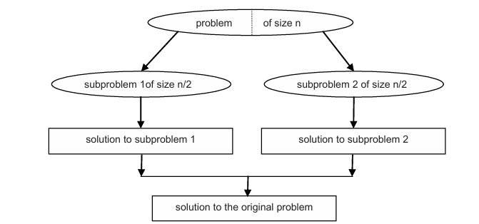
Divide-and-Conquer Algorithmic Strategy
The Divide-and-Conquer strategy is a fundamental algorithm design paradigm used to solve large problems by breaking them into smaller, manageable subproblems.
Definition: Divide-and-Conquer is an algorithm design method that:
  Divides a problem into smaller subproblems.
  Conquers each subproblem by solving them recursively.
  Combines the solutions of the subproblems to produce the final answer.
Many efficient algorithms—such as Merge Sort, Quick Sort, Binary Search, Fast Fourier Transform (FFT)—are based on this strategy.

Slide 22
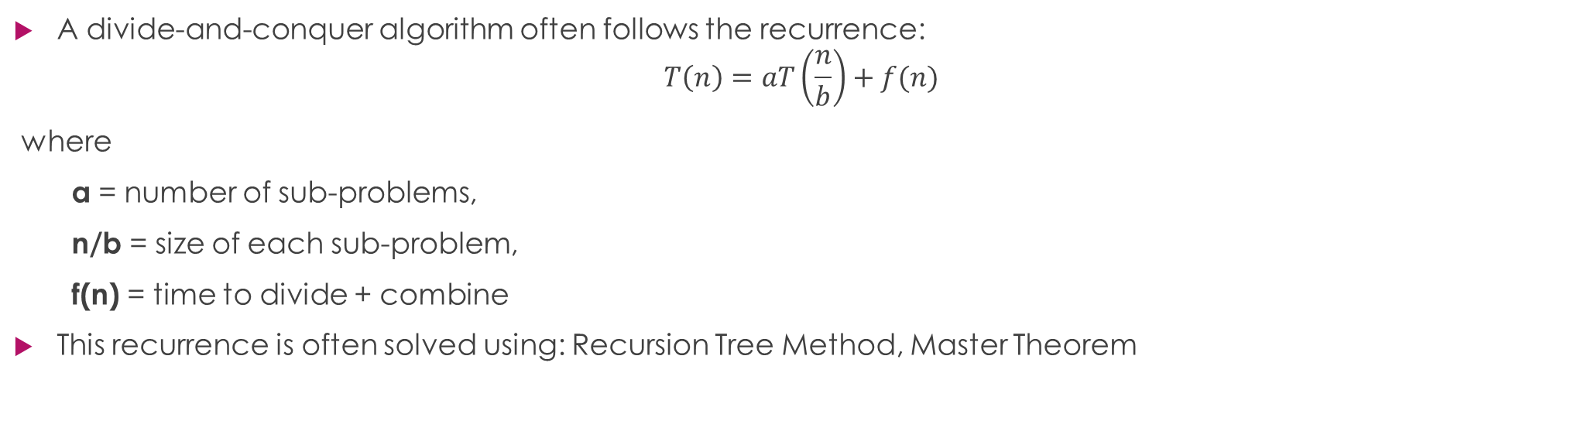
General Recurrence Relation for Divide-and-Conquer Strategy
A divide-and-conquer algorithm often follows the recurrence:
$$T\left(n\right)=aT\left(\frac{n}{b}\right)+f(n)$$
where
a = number of sub-problems,
n/b = size of each sub-problem,
f(n) = time to divide + combine
This recurrence is often solved using: Recursion Tree Method, Master Theorem

Slide 23
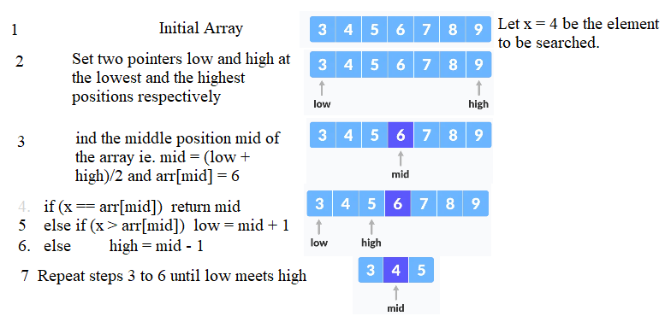
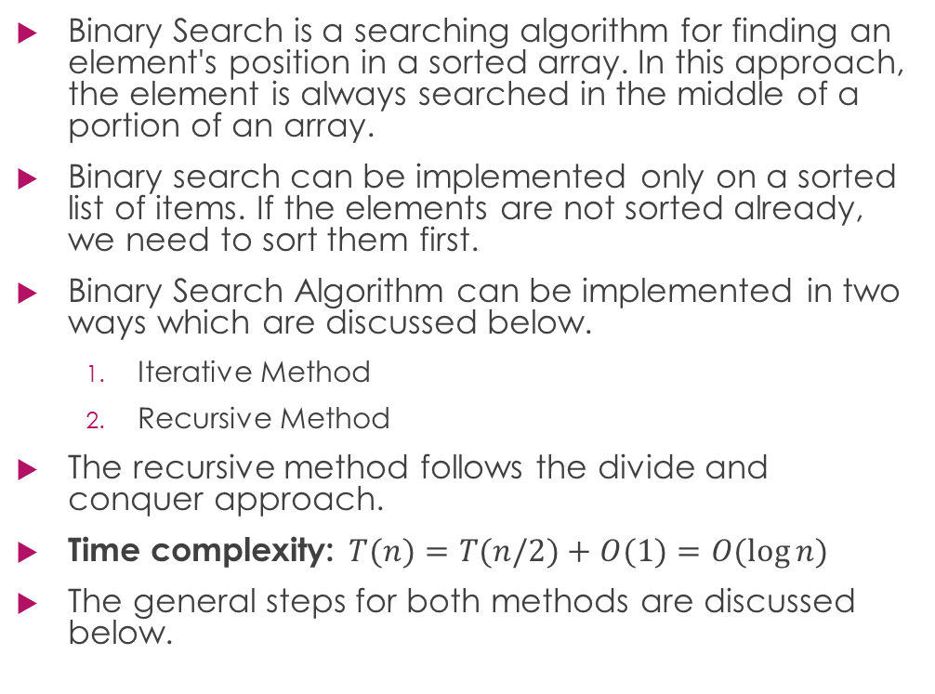
Binary Search
Binary Search is a searching algorithm for finding an element's position in a sorted array. In this approach, the element is always searched in the middle of a portion of an array.
Binary search can be implemented only on a sorted list of items. If the elements are not sorted already, we need to sort them first.
Binary Search Algorithm can be implemented in two ways which are discussed below.
  Iterative Method
  Recursive Method
The recursive method follows the divide and conquer approach.
Time complexity: $T(n)=T(n/2)+O(1)=O(log⁡n)$
The general steps for both methods are discussed below.

Slide 24
Binary Search Algorithm
Iteration technique
Recursive Method
do until the pointers low and high meet each other.
mid = (low + high)/2
if (x == arr[mid])
return mid
else if (x > arr[mid]) // x is on the right side
low = mid + 1
else // x is on the left side
high = mid - 1
binarySearch(arr, x, low, high) // Recursive approach
if low > high
return False
else
mid = (low + high) / 2
if x == arr[mid]
return mid
else
if x > arr[mid] // x is on the right side
return binarySearch(arr, x, mid + 1, high)
else // x is on the left side
return binarySearch(arr, x, low, mid - 1)

Slide 25
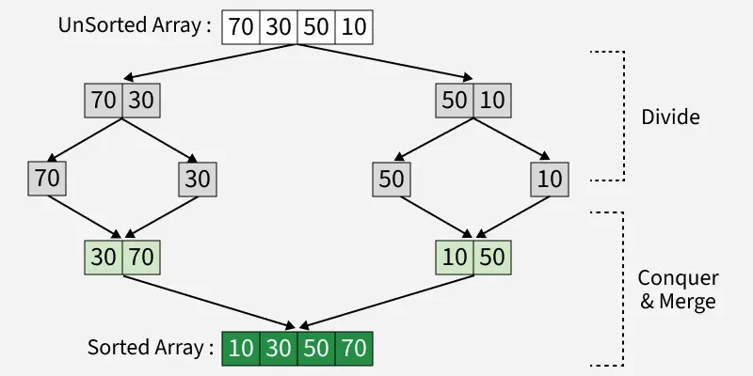
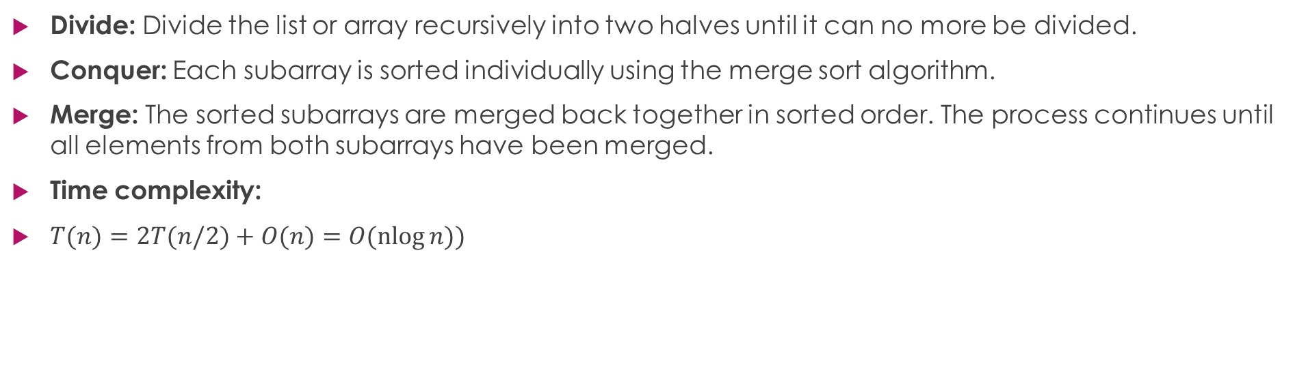
Merge Sort
Divide: Divide the list or array recursively into two halves until it can no more be divided.
Conquer: Each subarray is sorted individually using the merge sort algorithm.
Merge: The sorted subarrays are merged back together in sorted order. The process continues until all elements from both subarrays have been merged.
Time complexity:
$T(n)=2T(n/2)+O(n)=O(nlog⁡n))$

Slide 26
Merge Sort Algorithm
procedure merge( var a as array, var b as array )
var c as array
while ( a and b have elements )
if ( a[0] > b[0] )
add b[0] to the end of c
remove b[0] from b
else
add a[0] to the end of c
remove a[0] from a
end if
end while
while ( a has elements )
add a[0] to the end of c
remove a[0] from a
end while
while ( b has elements )
add b[0] to the end of c
remove b[0] from b
end while
return c
end procedure
procedure mergesort( var a as array ) if ( n == 1 )
return a
var l1 as array = a[0] ... a[n/2] var l2 as array = a[n/2+1] ... a[n] l1 = mergesort( l1 )
l2 = mergesort( l2 )
return merge( l1, l2 )
end procedure

Slide 27
Quick Sort
Divide: Choose a pivot and partition array
Conquer: Recursively sort left and right partitions
Combine: No merge needed
Time complexity:
  Average case: O(nlog⁡n)
  Worst case: O(n²)

Slide 28
Quick Sort Algorithm
procedure quickSort(left, right)
if right-left <= 0
return
else
pivot = A[right]
partition = partitionFunc(left, right, pivot)
quickSort(left,partition-1)
quickSort(partition+1,right)
end if
end procedure
function partitionFunc(left, right, pivot)
leftPointer = left
rightPointer = right - 1
while True do
while A[++leftPointer] < pivot do
//do-nothing
end while
while rightPointer > 0 && A[--rightPointer] > pivot do
//do-nothing
end while
if leftPointer >= rightPointer
break
else
swap leftPointer,rightPointer
end if
end while
swap leftPointer,right
return leftPointer
end function

